Slide 1
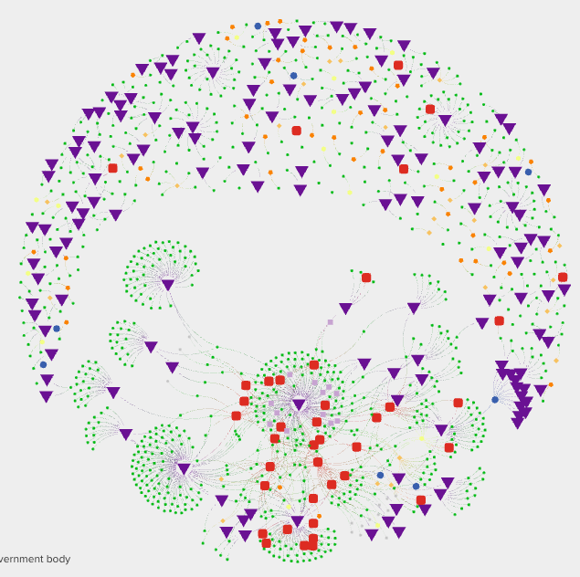
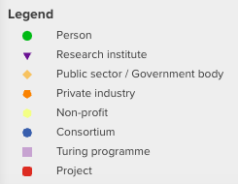
We need a detailed, global open research map
cassandra.gouldvanpraag@gmail.com | github:@cassgvp | September 2024
Open research is silo’d, limiting our efficacy for collaboration and understanding of system change
Cassandra Gould van Praag (she/her)

Slide 2
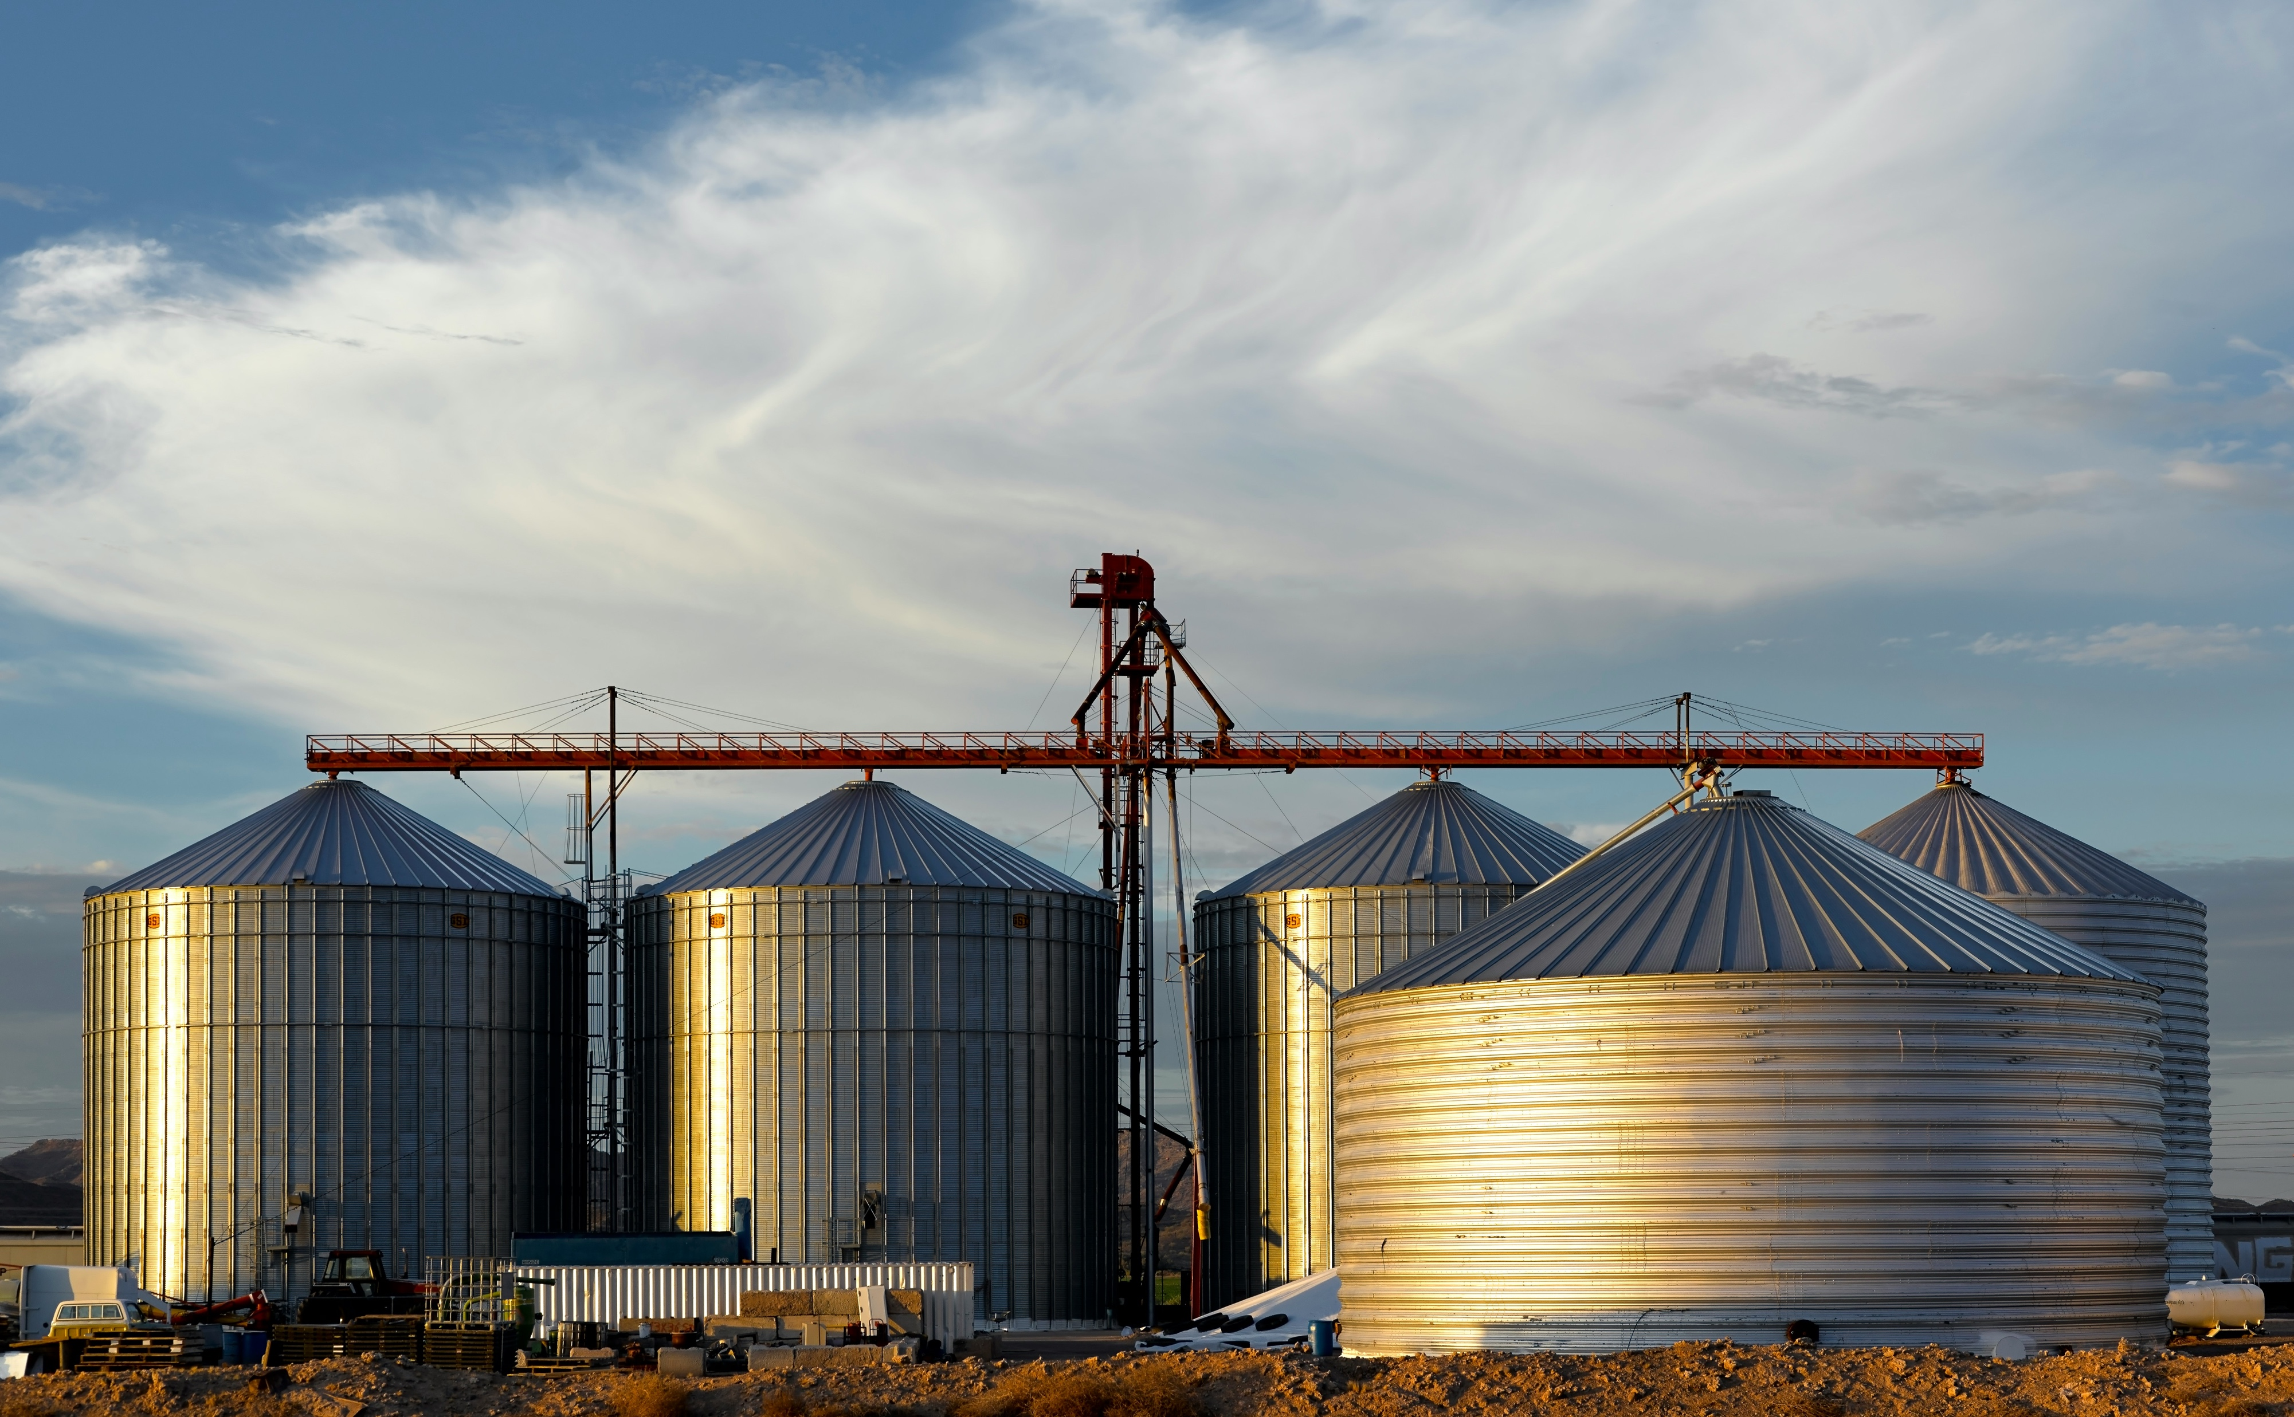
Open research is silo’d
Open research actors in the same city do not know each other
Closed knowledge of relationships and activities
Exclusion, dilution of power, and inefficiencies
Mapping projects have been incomplete and relied on static (expired) data
Not built for building community
Few have used best practice in open collaboration
We cannot effectively strategize or monitor system change with incomplete data

Slide 3
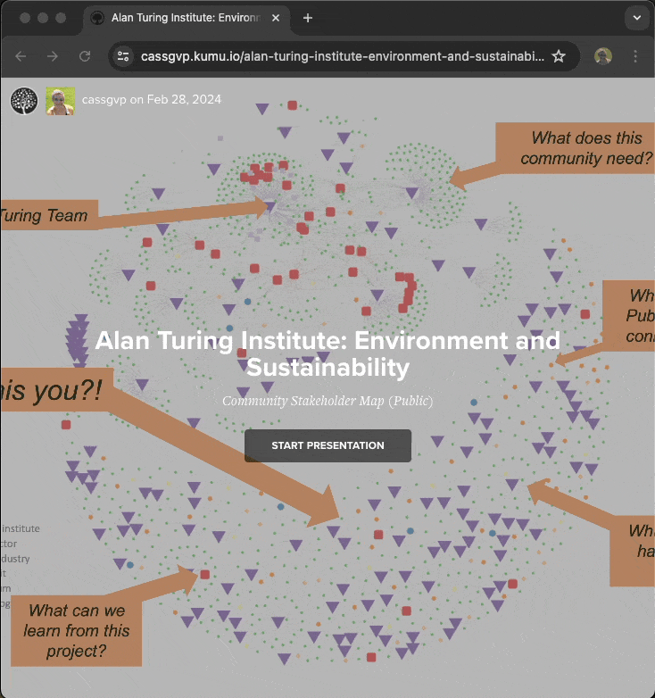
Build a global open research community
1. A dynamic and detailed map of global open research activities
High quality data to understand system change activity and inform strategy
Community resource for visibility and collaboration
2. An engaged and empowered community of contributors
Formal community building methods to deliver for community needs and high value return
All work developed openly, and with active and diverse stakeholder engagement
Build for sustainability and community ownership

Slide 4
Roadmap
1. Desk research
Collate information about active communities, activities, policies, actors in open research.
2. Data wrangling
Develop and extend categories for mapping and system monitoring.
3. Automation
Develop methods for user data entry and validation, supported by LLM data extraction.
4. Engagement (Phase 1)
Publish and socialise map for early community updates and improvement of user experience.
5. Engagement (Phase 2)
Formal and diverse qualitative stakeholder analysis to determine community needs and value return.
6. Strategy
Develop strategy to deliver sustainable contributions and data reuse.
7. Sustainability
Develop governance and pathways for contribution and leadership
8. System change
Use mapped data to evidence, understand and facilitate adoption of open research principles.

Slide 5
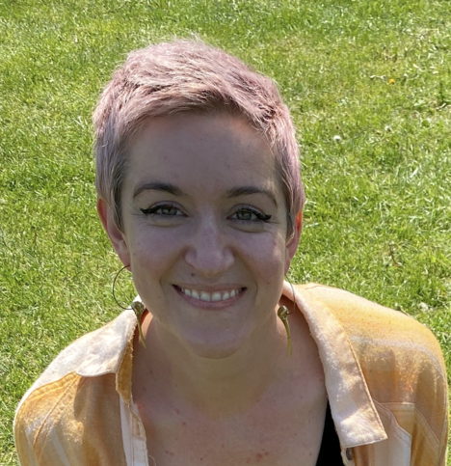
Credentials
Senior Research Community Manager (RCM)
Experience building community strategy, infrastructure and events
Alan Turing Institute, University of Oxford, and independent community groups
Large scale data infrastructure and tooling
Open Research Calendar: n>1,300 community contributions since 2021
Actionable stakeholder mapping (tinyurl.com/turing-es-map)
Qualitative and quantitative research skills (PhD brain imaging and Informatics)
Expertise and research data management design and GDPR
Influential open and ethical research advocate
International speaker and leader in open research and EDI
Contributor to global community, monitoring and funding initiatives

Slide 6

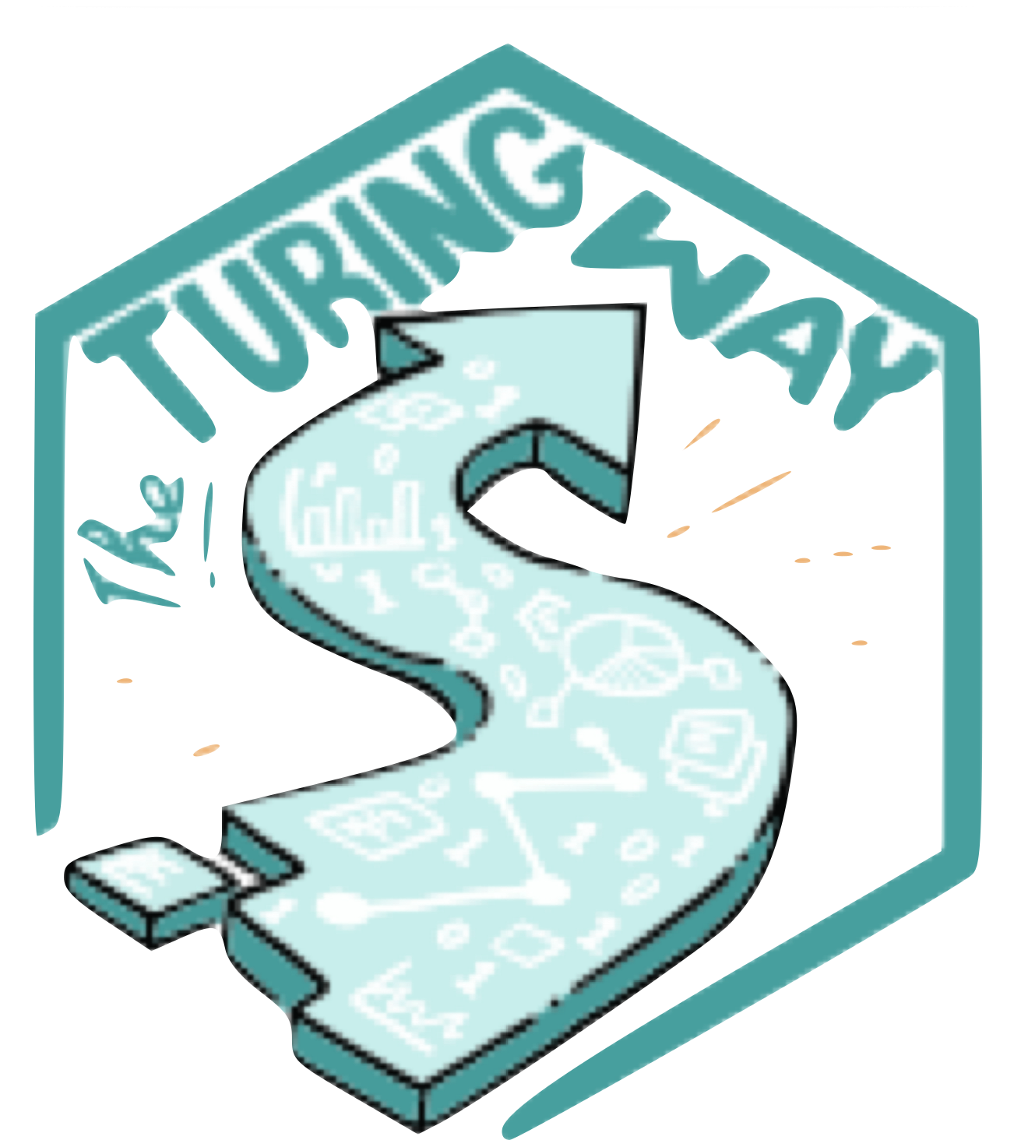
Community contributed
Visibility and collaboration
Expert open RCM
Extensive data
Interactive
System change
CREDITS: Slide template via slidesgo. All images CC-0 or otherwise credited.
OPEN RESEARCH MAP
Empower community to grow organically
Make contributions valuable – return to individuals
Showcase best practice in open research
doi: 10.5281/zenodo.13924979 CC-BY 4.0
Broad scope to make the data valuable for reuse
Engaging front end for compelling communication
Significant contribution to understanding reform
5
cassandra.gouldvanpraag@gmail.com | github:@cassgvp | Global Open Research Community | September 2024

Slide 7
Ask: Scoping: 18 months, £299,000
Item | Budget
Direct
1.0 Senior RCM 18 months | £85,327.50
1.0 RSE 12 months | £45,285.00
Direct non-staff
Travel and subsistence | £15,000.00
Consumables, software licenses, compute, marketing materials | £15,000.00
Residential community hackathon | £50,000.00
Indirect
RCM Tax, NI, pensions 10% 18 months | £34,672.50
RSE Tax, NI, pensions 10% 18 months | £14,715.00
Fiscal sponsorship OLS @15% | £31,591.00
Total | £299,000.00
Notes:
Align wages to Turing standards? These are ballpark!
Lots of travel for promotion/engagement
No idea on software licenses/compute! E.g. Will I be able to use OLS zoom?
Residential hackathon as an integral part of community building
Tax etc. calculated via monesavingexpert.com

